Slide 1
International Business Projects
Marketing and Market Research
Syllabus WT 2026/27

Slide 2
Module Convenor – Dr Arne Floh
Personal Information
Contact Information
Senior Lecturer in International Marketing – WU Vienna
Deputy Program Director Export- und Internationalisierungsmanagement
WWW: https://www.wu.ac.at/en/welthandel/arne-floh/
LinkedIn: http://www.linkedin.com/arnefloh
T: 01 31336 6367
E: arne.floh@wu.ac.at
Room D1.5.068
Office Hours: by appointment

Slide 3





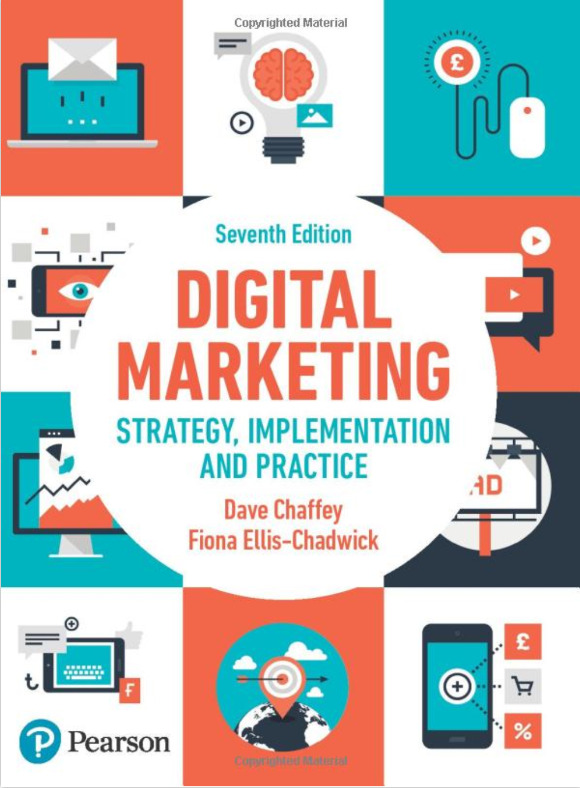






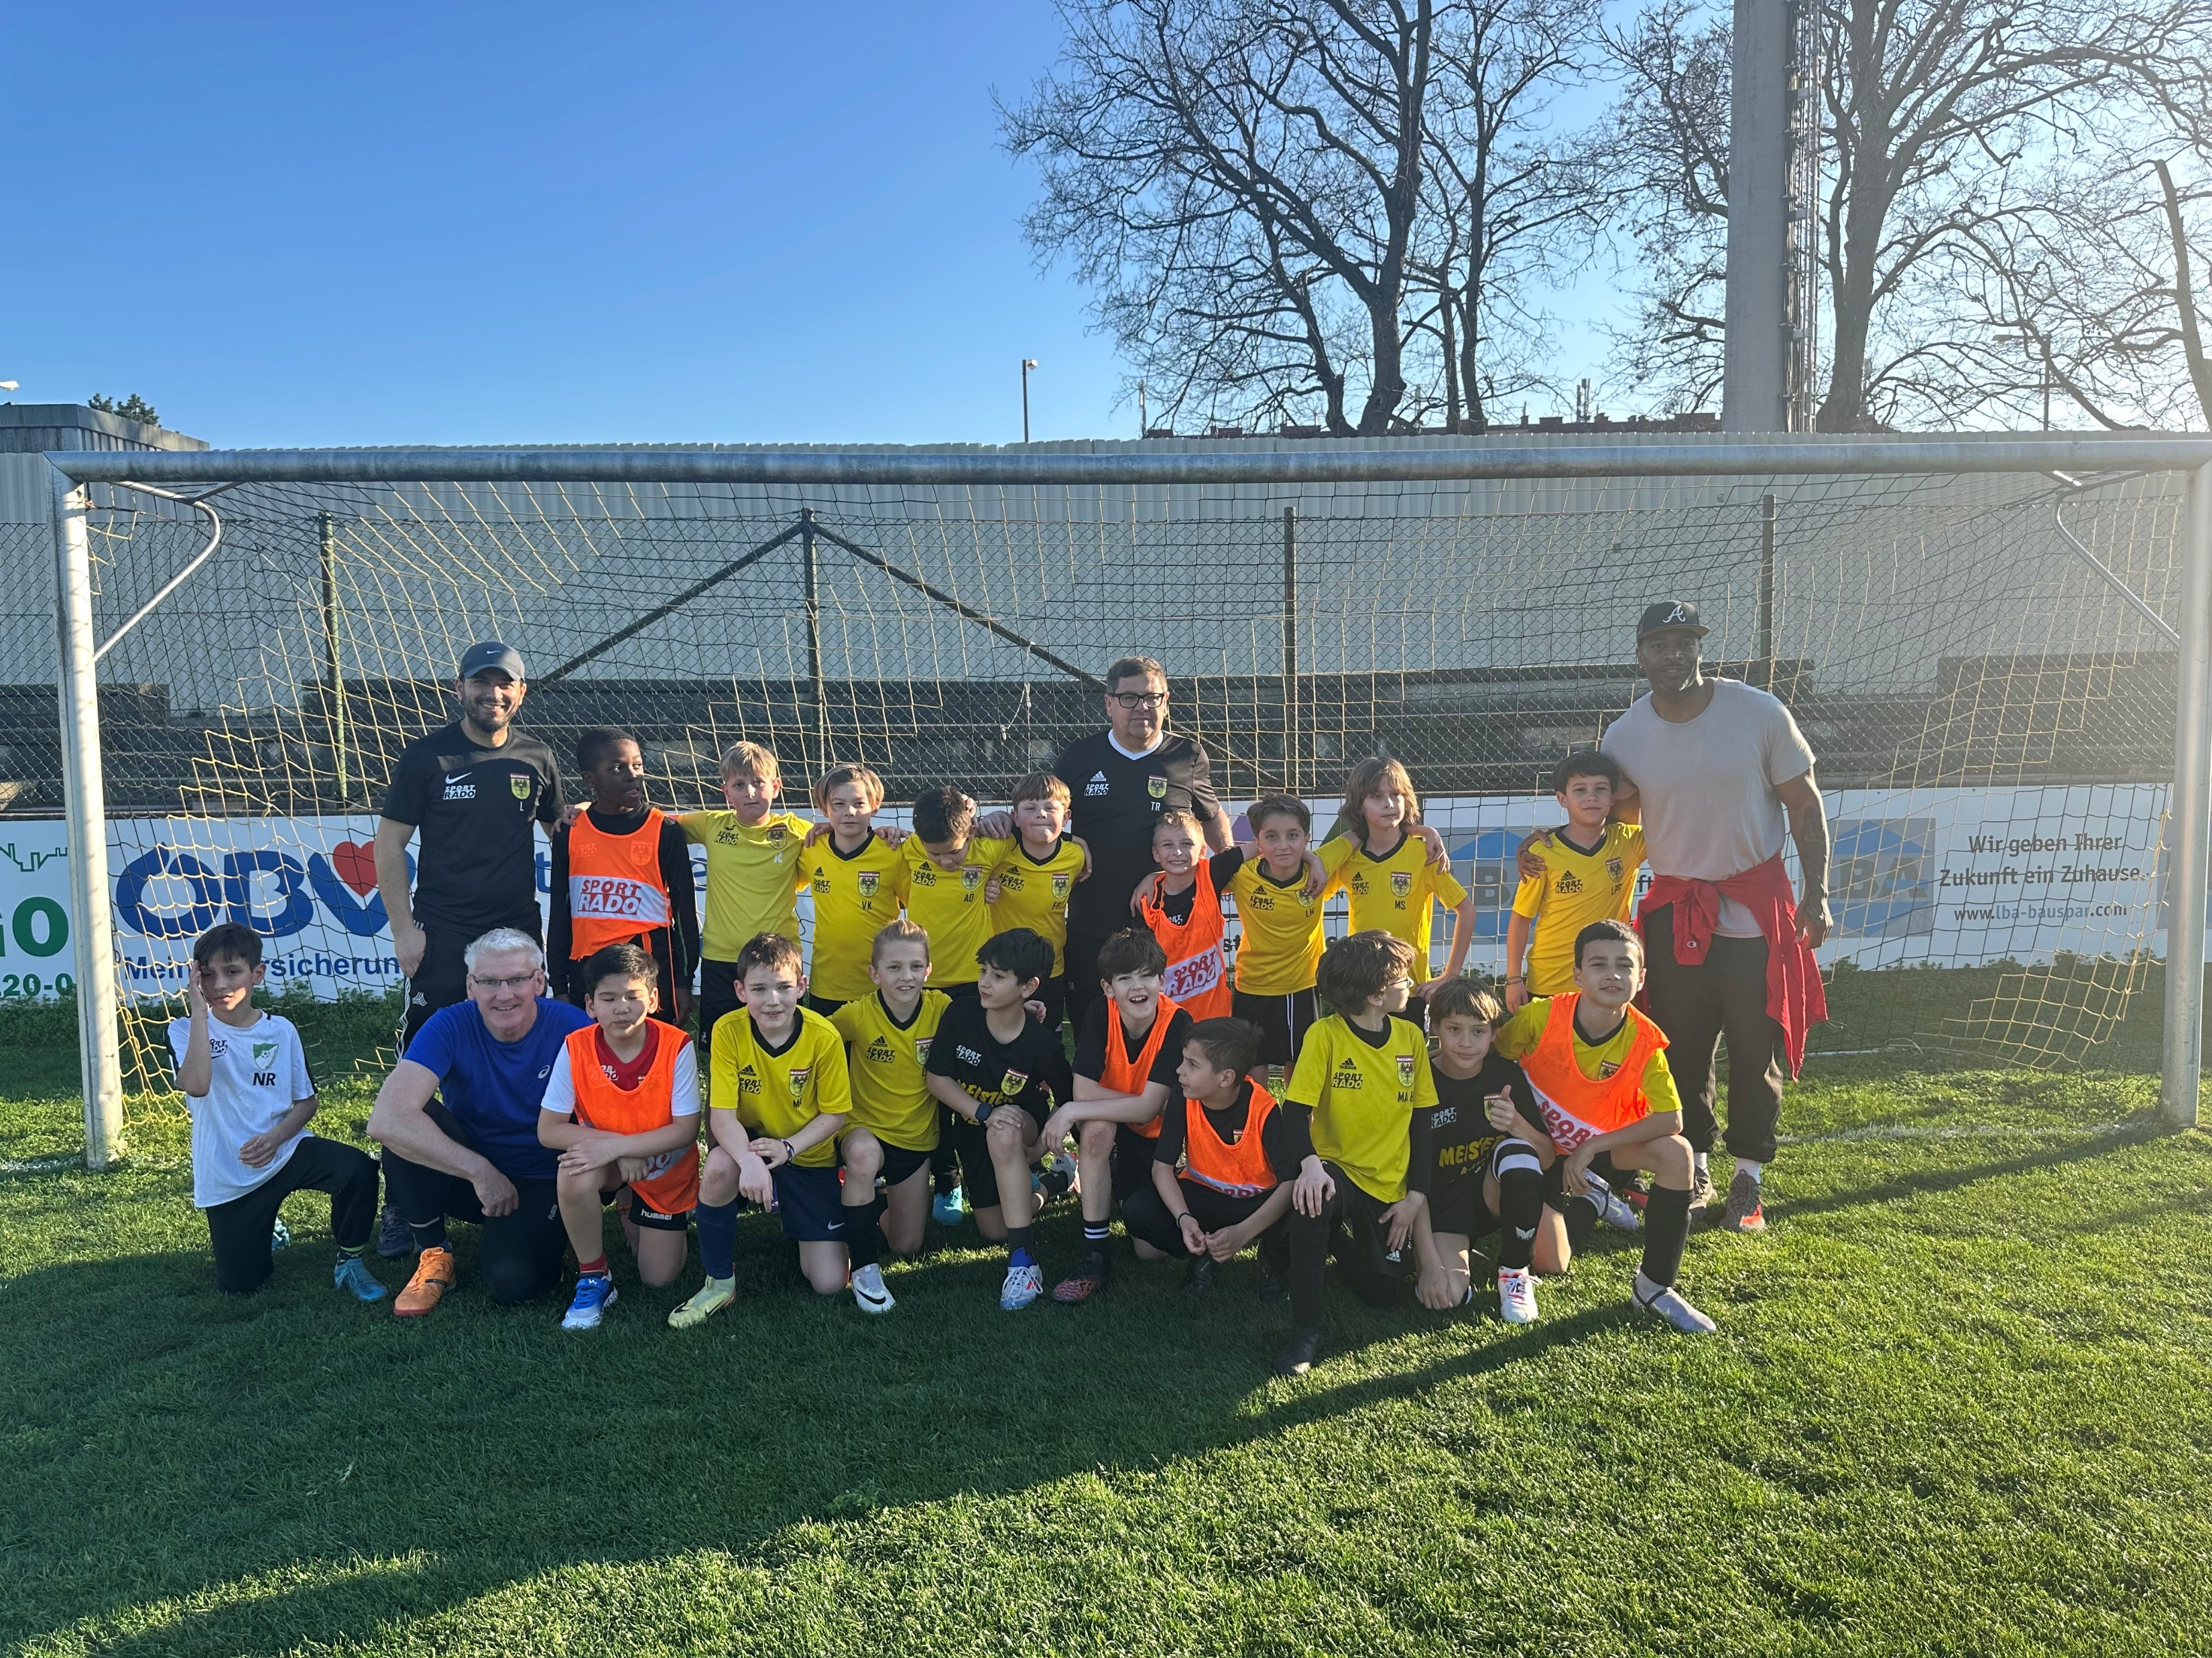

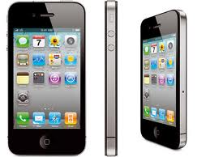
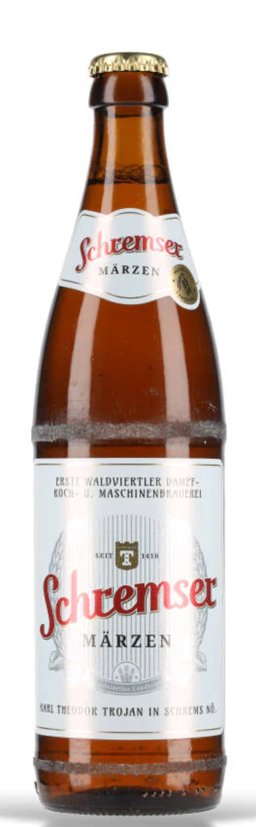
Module Convenor – Dr Arne Floh
  Work Experience
    International & Industry Background
    Teaching Experience > 25 Years
  Teaching
    International Marketing
    International Business Projects
    Marketing Research and Marketing Analytics
    Global Branding
    Supervision (BSc, MSc, PhD)
  Research
    Dynamic Capabilties and Firm Performance
    GenAI and Marketing
    SMEs and Internationalization
  Private
    Football
    Electronic Gadgets
    Austrian Wine

Slide 4
Course synopsis
Capstone-style course for students specializing in International Business
Core task: develop a comprehensive international marketing plan
Marketing and marketing research at the core: investigate markets systematically and evaluate opportunities and risks
Emphasis on critical thinking, project management and teamwork in a multicultural context
Outcome: a structured international marketing plan with evidence-based strategic recommendations

Slide 5
Learning objectives
Research &
analysis
Conduct and interpret marketing research for evidence-based decisions
Analyze competition, customer needs and cultural influences
Strategy &
planning
Design and present a structured international marketing plan based on systematic analysis and research
Apply marketing concepts internationally and evaluate opportunities and risks across markets
Develop creativity and problem-solving to propose innovative, feasible strategies
Teamwork &
communication
Strengthen teamwork, project management and intercultural collaboration
Communicate complex ideas clearly and persuasively, in writing and orally

Slide 6
Teaching and learning: flipped classroom
Before class
In class
Independent research on key concepts and methods
Preparation for the next session’s task
Self-directed learning
Discussion and application
Coaching sessions and progress reports
Peer feedback
Theory directly connected to the project task

Slide 7
The Julius Meinl case
Marketing plan for entering Latin America

Slide 8
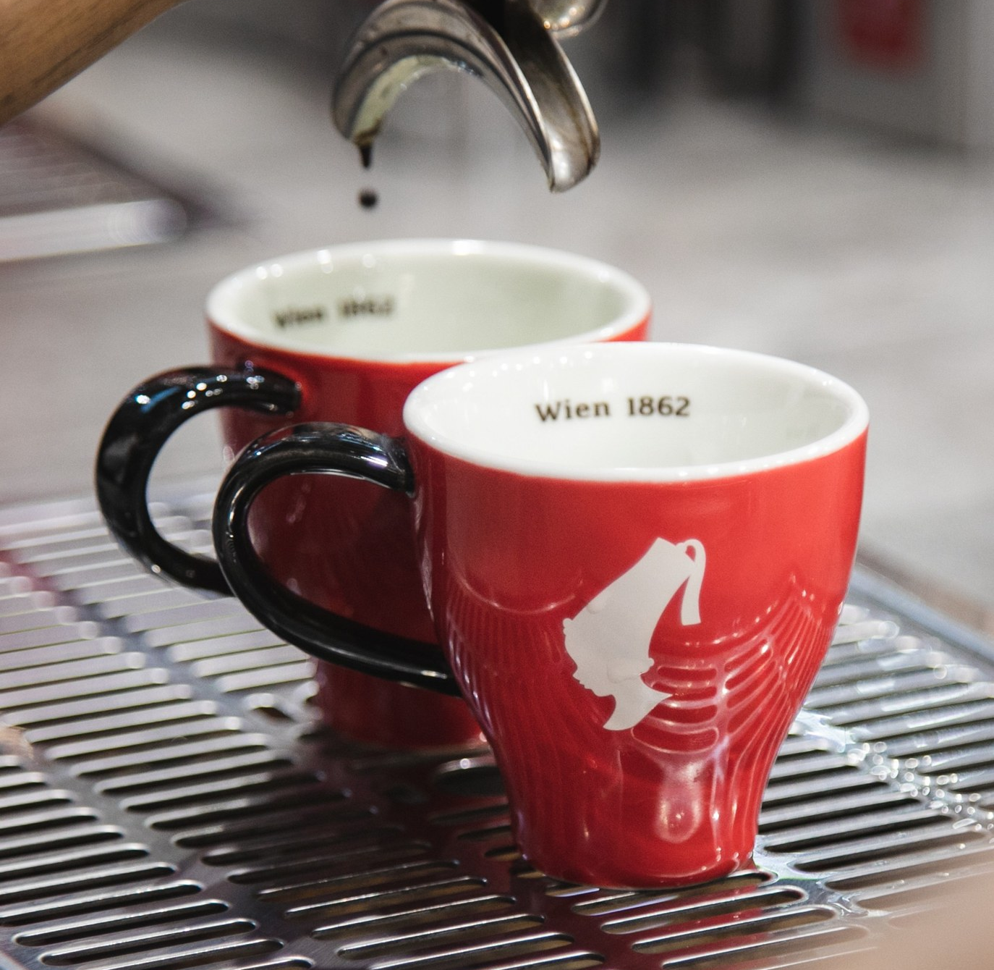

Our partner: Julius Meinl
1862
family-owned Viennese coffee roaster, now in its fifth generation
70+
countries: mostly through local distribution partners
2
segments per market: hospitality and grocery retail
Positioning: Viennese coffee house culture rather than the bean itself, meaning service, hospitality and the idea of taking time for a cup of coffee

Slide 9
How Julius Meinl sells: two segments, two partners
Hospitality (HoReCa)
Grocery retail
Cafés, restaurants and hotels
The primary segment: hotels matter most, with breakfast and bar business
A dedicated partner, because hotels and grocery chains are different businesses
Coffee for the home, through grocery chains and delicatessen
Premium assortment
A dedicated partner: with no own sales organisation in export markets, the partner is the sales force

Slide 10
Who Julius Meinl sells to
Hospitality
Hotels with breakfast and bar service, especially with international guests; premium restaurants and cafés; venues where coffee is part of a quality experience
Retail
Grocery and delicatessen with a premium assortment; shoppers who can pay a premium price; places where brands such as illy are already on the shelf
Less relevant
Venues and retailers competing on price, and areas without purchasing power

Slide 11
The question: growth in Latin America
Julius Meinl sees Latin America (South America and Mexico) as a potential future growth region, where it is currently not present or only marginally.
1 Which Latin American markets are attractive?
2 How could market entry look?
3 How should the brand be marketed?
Central question: Many Latin American countries grow and roast their own coffee and have a strong coffee culture. Why would cafés, hotels, retailers and consumers choose a coffee brand from Vienna, and who exactly would do so?

Slide 12
Six markets, one set of criteria
Markets compared by all groups
Example criteria
Size of the premium coffee segment (HoReCa and retail)
Tourism and international hotel presence
Purchasing power and economic development
Competitive landscape
Import conditions and regulation
Coffee culture and consumption habits
Mexico
Colombia
Brazil
Chile
Uruguay
Argentina
Simplified outlines, not to scale

Slide 13
Assessment strategy
Three group presentations, self-reflection and peer review

Slide 14
Overview of the presentations
Presentation | Length | Weight | Focus
1 Content presentation | 15 min | 20 % | Market selection tools: theory, real-world applications, pitfalls
2 Midterm presentation | 20 min | 30 % | Market selection and competitor analysis
3 Final presentation | 25 min | 30 % | Marketing implementation plan

Slide 15
Presentation 1: market selection tools
1 Content
15 min · 20 %
2 Midterm
20 min · 30 %
3 Final
25 min · 30 %
Review the tools companies use to screen, compare and select international markets
Cover the theory, real-world applications and typical pitfalls (e.g., data availability, subjective weighting, outdated indicators)
Recommend the tool best suited to compare the six Latin American markets for Julius Meinl
Format: max. 15 minutes and 15 slides, information-rich with clear visualizations
Document all sources in a separate Excel sheet

Slide 16
Presentation 2: midterm
1 Content
15 min · 20 %
2 Midterm
20 min · 30 %
3 Final
25 min · 30 %
Part A: Market selection
Part B: Market and competitor analysis
Compare the six countries using the same criteria
Apply the tool chosen in the content presentation, transparently and replicably
Rank the countries and justify the ranking
Discuss the sensitivity of the ranking to criteria and weights
Submit one Excel file and one presentation file; end with a justified recommendation
Deep-dive into the assigned country
Out-of-home and at-home coffee consumption
Premium brands present and their prices
Distribution in HoReCa and retail; import conditions
Competitor positioning and communication
Online analysis of the target city (menus, shelf prices, reviews, social media)

Slide 17
Presentation 3: marketing implementation plan
1 Content
15 min · 20 %
2 Midterm
20 min · 30 %
3 Final
25 min · 30 %
Market entry and marketing plan for the assigned market: how the brand is marketed and how Julius Meinl enters the market
  Target segment and first customers
  Positioning, incl. the answer to the central question
  Price positioning vs. competition
  Distribution via a local partner, incl. a profile of a suitable partner
  Communication and in-market activation (incl. creative implementation)
  Rough timeline, first-year KPIs and key risks
Format: max. 25 minutes

Slide 18
Grading
Grade components
Grading scale
1 (90–100 %)
2 (80–89 %)
3 (70–79 %)
4 (51–69 %)
5 (0–50 %)

Slide 19
Teaching schedule
Session 1
Session 2
Session 3
Session 4
Course content and logistics
→ Prepare content presentation
Content presentation
→ Country comparison, selection model
Coaching session, progress report
→ Refinement and revision
Coaching session, progress report
→ Prepare midterm presentation
Session 5
Session 6
Session 7
Session 8
Midterm presentation
→ Assigned market, marketing plan
Coaching session, progress report
→ Refinement and revision
Coaching session, progress report
→ Prepare final presentation
Final presentation
→ Self-reflection, peer review

Slide 20
Data sources and framework conditions
Framework conditions
Possible sources
The project is based on publicly available data
Julius Meinl provides no internal figures (revenues, margins, prices, partner names); none are needed
When contacting companies or individuals, act as students on a university project, not on behalf of Julius Meinl
USDA coffee country reports
Coffee import trade statistics
National tourism statistics
Public Julius Meinl material (corporate story, sustainability report, website)

Slide 21
AI, self-reflection and peer review
Use of AI
Self-reflection and peer review
Use of (Generative) AI tools is explicitly encouraged
Tell a rich story in your presentations
Be honest: list all tools you used
Graded on quality, innovativeness and variety of sources
Self-reflection: one page on what you learned, what you liked and what can be improved
Peer review: rate the engagement and performance of your group mates (not yourself); kept confidential
Submit via Canvas until one week after the last session

